Slide 1


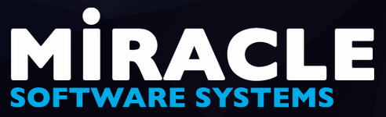
Building cloud enabled applications
using Windows Azure

Slide 2


Kunal Chowdhury
Microsoft MVP (Windows Development)
Windows 10 Champion | Windows Insider | Tech Buff
Author | Passionate Blogger @ kunal-chowdhury.com
Twitter: @kunal2383
Notes:
http://bit.ly/digitalsummit17

Slide 3

What is Cloud Computing?
It is a model to enable access to shared pools of configurable resources.
It can be rapidly provisioned with minimal effort, often over the Internet.
It allows users and enterprises to store and process data either in a privately-owned cloud, or on a third-party server located in a data center.

Slide 4
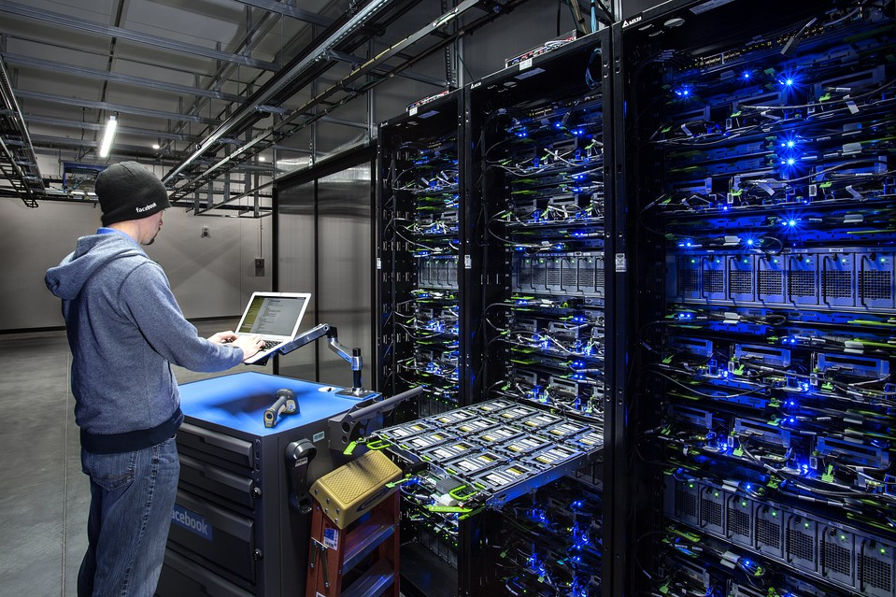


Slide 5
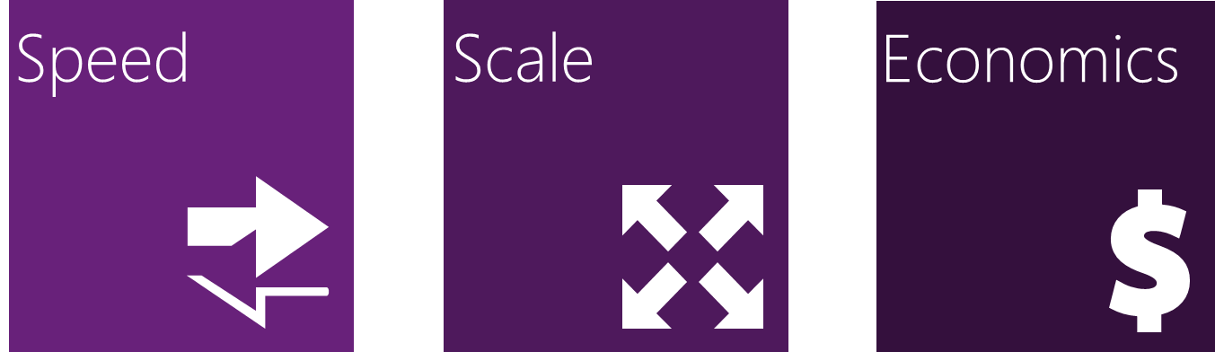
Why Cloud?
Makes data-accessing mechanisms more efficient, reliable.
Relies on sharing of resources to achieve economy of scale.
Reduces cost by increasing daily activities and efficiency.

Slide 6
The cloud computing basics
Infrastructure as a Service (IaaS) – Fundamental building blocks of cloud computing resources, which takes the physical computer hardware to build virtual infrastructure.
Platform as a Service (PaaS) – Provides a platform where you can develop software and deploy them.
Software as a Service (SaaS) – Uses the web to deliver software applications for end users, which are managed by third-party vendors.
Notes:
IaaS – Amazon Web Service, Microsoft Azure, Google Compute Engine
PaaS – Google App Engine, Heroku
SaaS – Office 365, Google Apps, Dropbox, OneDrive

Slide 7
The cloud computing basics
On Premises
Infrastructure
(as a Service)
Platform
(as a Service)
Software
(as a Service)
Applications
Applications
You manage
Applications
Applications
You scale, make resilient and manage
You scale, make
resilient & manage
Data
Data
Data
Data
Runtime
Runtime
Runtime
Runtime
Scale, resilience and management by vendor
Middleware
Middleware
Middleware
Scale, resilience and management by vendor
Middleware
O/S
O/S
O/S
O/S
Virtualization
Virtualization
Managed by vendor
Virtualization
Virtualization
Servers
Servers
Servers
Servers
Storage
Storage
Storage
Storage
Networking
Networking
Networking
Networking
Notes:
IaaS – Amazon Web Service, Microsoft Azure, Google Compute Engine
PaaS – Google App Engine, Heroku
SaaS – Office 365, Google Apps, Dropbox, OneDrive

Slide 8
The cloud computing basics
Infrastructure as a Service (IaaS) – Fundamental building blocks of cloud computing resources, which takes the physical computer hardware to build virtual infrastructure.
Platform as a Service (PaaS) – Provides a platform where you can develop software and deploy them.
Software as a Service (SaaS) – Uses the web to deliver software applications for end users, which are managed by third-party vendors.
Notes:
IaaS – Amazon Web Service, Microsoft Azure, Google Compute Engine
PaaS – Google App Engine, Heroku
SaaS – Office 365, Google Apps, Dropbox, OneDrive

Slide 9
Focus on functionality…
Let others take care of:
Resources and Securities
Staging and Production environments
Availability, scalability and load balancing
Fault tolerance
OS - installation, licensing, updates, patches
Network and Maintenance
Notes:
Less worries, focus on functionality. Let others take care rest of the things…

Slide 10
What is Azure?
A comprehensive set of cloud services that developers and IT professionals use to build, deploy and manage applications through a global network of Microsoft datacentres.
It provides integrated tools, DevOps and a marketplace to support you to efficiently build anything from simple mobile apps to web applications.
Windows Azure – February 1, 2010
Microsoft Azure – March 25, 2014
Notes:
Microsoft Azure is an open, flexible, enterprise-grade cloud computing platform from Microsoft which was first released as ‘Windows Azure’ on 1st February 2010 and then got renamed as ‘Microsoft Azure’ on 25th March 2014. You can build, deploy, and manage applications and services using the Azure portal, globally available through the Microsoft data centers.
It basically delivers IaaS (Infrastructure as a Service), PaaS (Platform as a Service) and SaaS (Software as a Service) and supports different programming languages, tools, and frameworks to build and manage applications/services.

Slide 11
Why Azure?
Get your apps to market faster by using Azure integrated tools.
Build and deploy wherever you want and distribute data seamlessly across cloud.
Create data-driven, intelligent apps.
Take advantage of Microsoft security, privacy, and the most compliance coverage of any cloud provider.

Slide 12

Get started with FREE…
Start free with $200 credit to use all Azure products for 30 days.
Use the popular services for free for 12 months.
Use 25+ services, which are always available for free.
After free period, pay nothing until you choose to pay.
https://azure.microsoft.com/en-us/free/

Slide 13
Overview to Azure Portal

Slide 14
Azure Websites
App Services
BizTalk Services
Key app services in Azure today

Slide 15

Introducing Azure App Service
Unique integrated offering
Build rich, engaging & intelligent apps
Scale as your business grows
Azure Websites
App Services
BizTalk Services
Key app services in Azure today

Slide 16


One integrated offering
Web Apps
Mobile Apps
Web apps that scale with your business
Build Mobile apps for any device
LOGIC Apps
Api Apps
Automate business process across SaaS and on-premises
Easily build and consume APIs in the cloud
Notes:
App Service has everything you need to build apps that target both web and mobile clients from a single app back-end.
Using API Apps, you can connect your app to dozens of popular services like Office 365 and salesforce.com in minutes, and integrate your own APIs so they can be used within any app.
And finally with Logic Apps, you can automate business processes using a simple no-code experience.

Slide 17
What is Azure App Service?
Azure App Service is a fully managed “Platform as a Service” (PaaS), offering developers a rich set of capabilities to web, mobile.
Mobile Apps in Azure App Service offer a highly scalable, globally available mobile application development platform for Enterprise Developers.

Slide 18
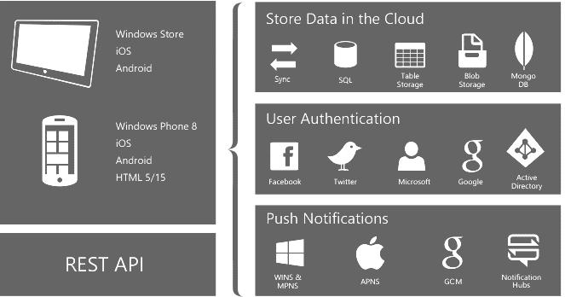

Slide 19
Building cloud enabled application
(Demo)

Slide 20
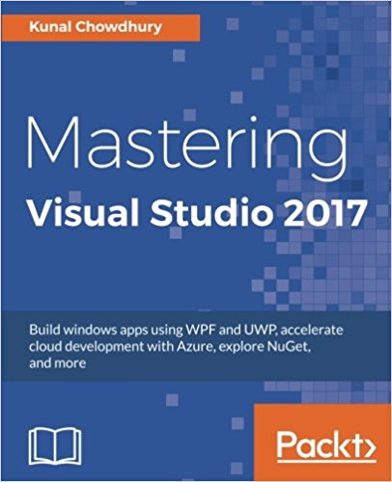
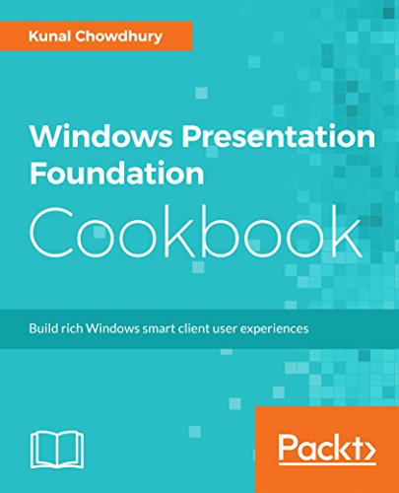
My Books
Amazon book store
http://bit.ly/kcbooks

Slide 21



kunal-chowdhury.com
twitter.com/kunal2383
fb.com/blog.kunal

Slide 22
Thank you ☺
Notes:
http://bit.ly/digitalsummit17

